Slide 1
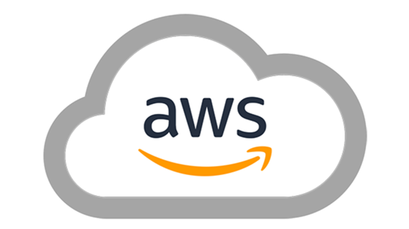
Amazon Web Services

Slide 2









Team 13: Data Crafters
Project Topics: Amazon Web Services
Presentation Dates: Oct 30, Dec 11
Jagadeesh Kammara | Haarika Polukanti | Sai Chandan Vuda | Jairam Mandi
Tech Lead | Team Coordinator | Co-researcher | Presentation Lead
MGS 613 – DBMS – Section 4S
Fall 2023

Slide 3
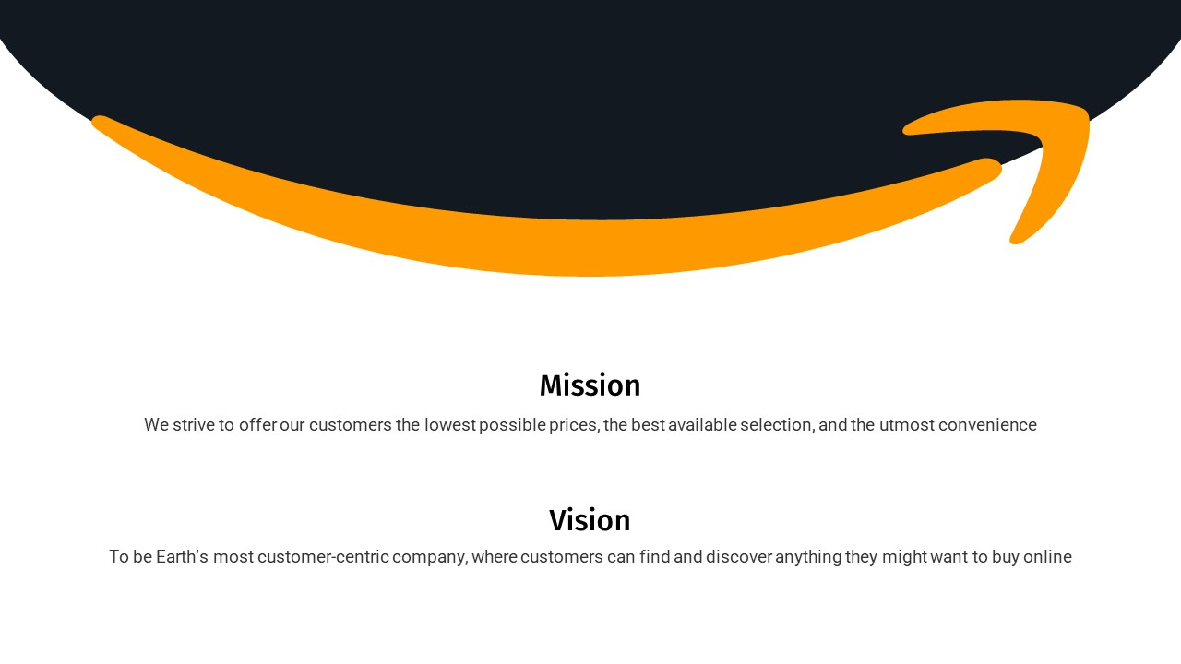
What is Amazon Web Services
It is a comprehensive and widely used cloud computing platform and infrastructure services provided by Amazon. AWS offers a wide range of cloud computing services, including computing power, storage, databases, machine learning, analytics, content delivery, and more.
These services are delivered on-demand over the internet, and customers can pay for the specific resources and services they use, often referred to as a "pay-as-you-go" model.

Slide 4
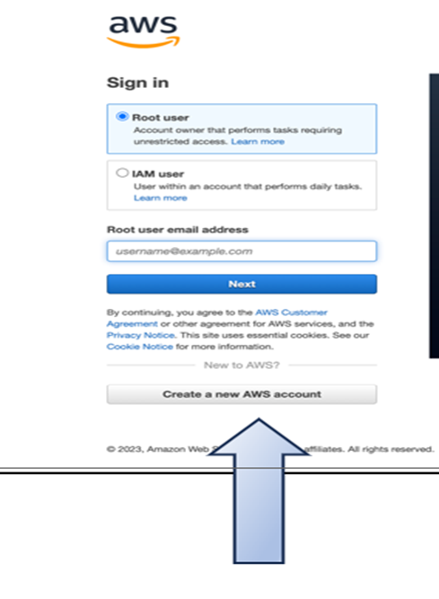
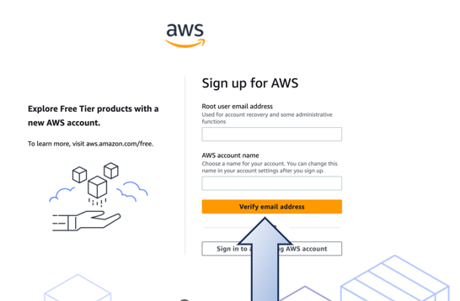
Demo: How To Create an AWS Account
Step 1. Go to https://aws.amazon.com and click on Complete Sign Up to create a new account.
Step 2. Create an Account
Step 3
Fill the required details and click on Verify email address.

Slide 5
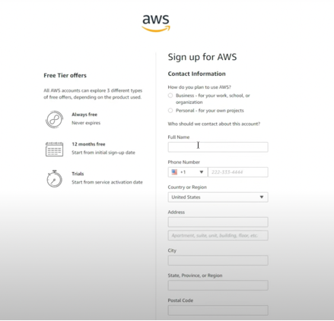
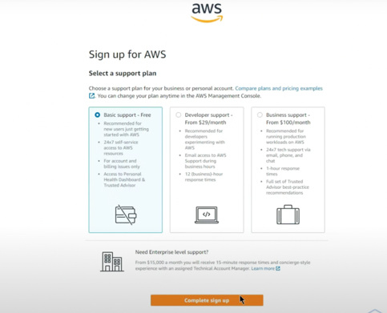
Step 4:
Once account is verified, create your password, and fill the Contact Information.
Step 5:
Enter the Billing Information and proceed with the next step.
Step 6: Select the Basic Support Free plan complete the signup.
Step 6:
Once you are done with the signup you, will get a confirmation mail for using the AWS account.

Slide 6
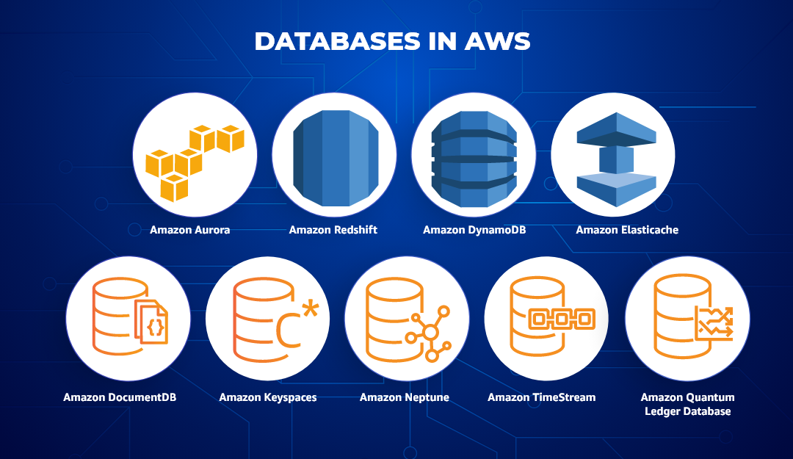

Slide 7
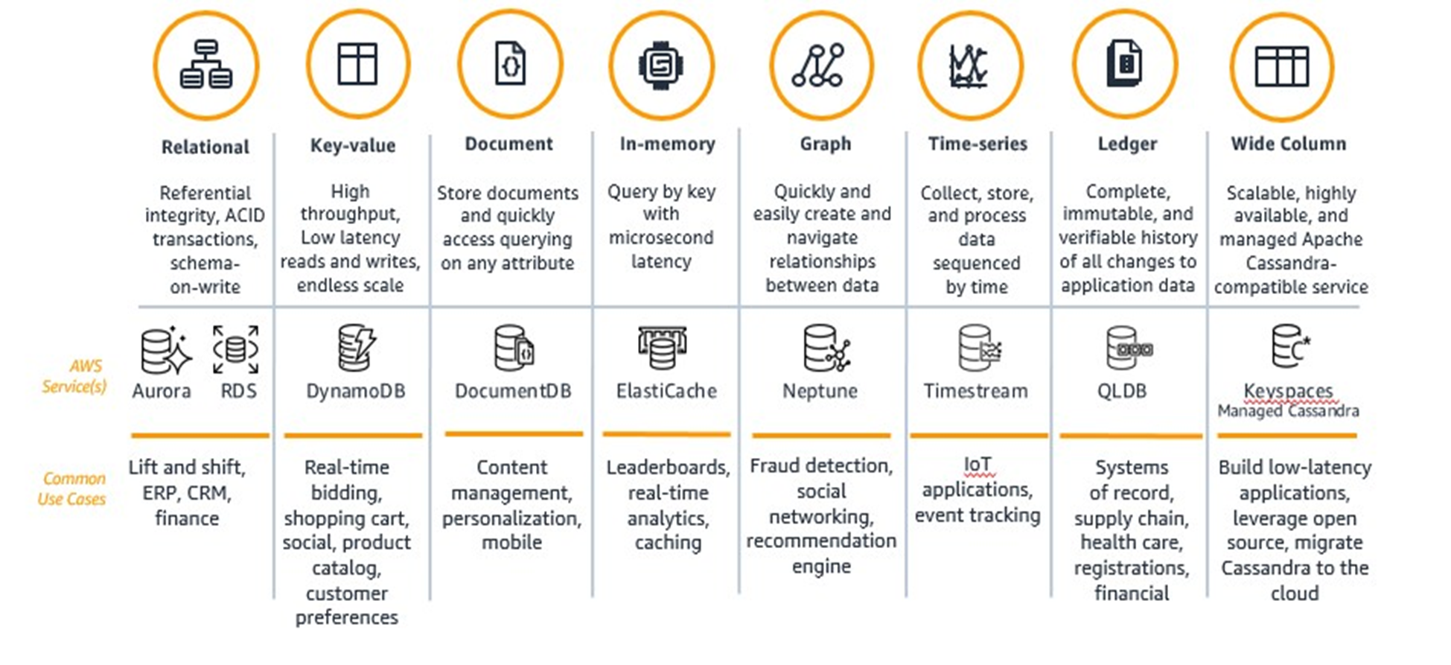
AWS Databases
https://aws.amazon.com/blogs/publicsector/purpose-built-databases-model-building-applications-cloud/

Slide 8
AWS database vs Traditional Database
AWS Database
Traditional Database
Ease of Management:
AWS handles routine tasks like backups, updates, and patch management, reducing operational overhead.
Scalability:
On-demand scalability without manual intervention. It has ability to scale up or down based on actual usage
High Availability:
AWS offers multi-AZ deployments, ensuring databases remain operational even if an entire data center experiences an outage.
Cost Efficiency:
With AWS's pay-as-you-go model, upfront investments are minimal, and you only pay for the resources you use.
Global Reach:
AWS's global infrastructure means you can deploy databases in regions across the world, optimizing for latency or regulatory needs.
Security
Automated backups, snapshots, and point-in-time recovery options are readily available.
Ease of Management:
Manual setup on local servers or data centers and DBA needed for routine maintenance, backups, and updates
Scalability :
Limited by physical hardware. Scaling often requires foresight, planning, and potential downtime.
High Availability:
Need manual configuration for high availability and disaster recovery.
Hardware failures can cause more extended downtimes.
Cost Efficiency:
Upfront costs for hardware and software.
Costs might be more predictable but could be higher for initial setup
Global Reach:
Setting up in multiple geographies requires more effort and cost.
Security
Security depends on internal teams.
Often need separate tools and manual patches

Slide 9
Amazon Relational Databases
Amazon Aurora
Amazon RDS
Amazon RedShift
Amazon Aurora is a high-performance, fully managed relational database service that is compatible with MySQL and PostgreSQL.
Aurora is optimized for online transaction processing (OLTP) workloads, Online Transaction Processing, or OLTP, is a form of data processing that involves completing several transactions concurrently, for example, online banking, shopping, order entry, or sending text messages. They’re designed to support high-volume, low-latency transactions is designed for high availability.
Supports read replicas for read scaling and has automated backups with a 30-day retention period.
Amazon RDS is a managed relational database service that supports several database engines, including MySQL, PostgreSQL, Oracle, SQL Server, and MariaDB.
Offers high availability and automatic failover through Multi-AZ deployments.(Available Zones)
Supports read replicas for read scaling and enables automated backups and automated software patching.
Amazon Redshift is a fully managed data warehousing service designed for analytics and business intelligence.
Redshift is optimized for online analytical processing (OLAP) workloads, which involve processing complex, large-scale queries that require aggregation and analysis from multiple data sources. OLAP systems are typically used for data analysis and reporting tasks, such as generating sales reports or analyzing customer behavior.
It is optimized for large-scale data warehousing with columnar storage.

Slide 10
Amazon Aurora
Amazon RDS
Amazon RedShift
Scalability:
Provides read scalability with Aurora Replicas and can automatically split read traffic across replicas. It can also automatically scale storage.
Performance:
Offers high performance with the ability to automatically replicate data across multiple Availability Zones.
It is known for low latency and high throughput.
Replication:
Supports replication across multiple Availability Zones for high availability.
Offers cross-region replication for disaster recovery.
Scenario: You're the Chief Technology Officer (CTO) for "GameSphere", a rising online multiplayer gaming platform across the world. As the platform has grown, so have the challenges with the existing database solution. The games require quick response times, the user base is expanding rapidly, and players demand a seamless experience across continents.
"GameSphere" decides to transition its primary game database to Amazon Aurora with the MySQL-compatible edition. Leveraging Aurora Global Database, they replicate game data across North America, Europe, and Asia-Pacific regions, drastically reducing latency issues and providing a consistent gaming experience to players worldwide.
Scalability:
Supports read replicas for certain database engines, but scaling can be more limited compared to Aurora. Storage can be scaled, but not as seamlessly as Aurora.
Performance:
Provides good performance for transactional workloads but may not be as performant as Aurora for read-heavy applications.
Replication:
Supports Multi-AZ deployments for high availability.
Provides read replicas for read scaling.
Scenario: You're the lead architect for "MediHealth", a startup aiming to create a healthcare management application that allows patients to book doctor appointments, access their medical records, get prescription refills, and communicate with healthcare professionals. Given the sensitivity of the data and the need for high availability, selecting the right database solution is critical.
MediHealth" opts for Amazon RDS with the PostgreSQL engine for its primary database solution. They set up a Multi-AZ deployment to ensure high availability and use RDS's security features to encrypt sensitive medical data.
Scalability:
Offers elastic resize for both the cluster and storage. You can easily scale Redshift to accommodate growing data volumes and query complexity.
Performance
Optimized for analytical workloads with columnar storage and parallel query processing. It excels in handling large datasets and complex analytics.
Replication:
Supports automatic backups and snapshots for data recovery.
Cross-region replication is not natively supported but can be implemented using other AWS services.
Scenario: For organizations dealing with substantial workloads and requiring seamless analytical operations, the AWS service is the optimal choice. It simplifies the process of obtaining real-time insights from vast amounts of structured or semi-structured data by seamlessly integrating with popular business intelligence tools like AWS QuickSight and Tableau.

Slide 11
Why we need to choose AWS over Azure ?
Case 1: You and a group of passionate developers have just started a new tech venture, "CodeFlare". The company's aim is to build an innovative project management tool for software teams. Being a bootstrapped startup, initial costs are a concern. Your team needs cloud resources for development, testing, and early-stage deployment but wants to minimize costs.
AWS: The 12-month free tier includes services you need: EC2 for virtual servers, RDS for databases, and S3 for storage. This can be handy for setting up a development environment and initial testing.
Azure: The $200 credits for the first 30 days allow you to quickly set up more powerful VMs and databases, giving flexibility to try out premium services that go beyond the basic free tiers.
Case 2: Imagine you run a popular e-commerce platform, "ShopStar". Black Friday is approaching, and you're expecting a massive surge in traffic and sales. In the past, the platform experienced downtimes during peak sales, leading to significant revenue losses and unhappy customers. This year, you want to ensure that your platform remains highly available, even in the face of unexpected issues. Then which Cloud database we will choose? AWS/Azure/ GCP
Since AWS has more AZ’s compared to Azure, so to have a more availability all over the world, we will choose AWS
Solution:
Your primary database is hosted on Amazon RDS in Availability Zone (AZ) A.
You enable Multi-AZ deployment, creating a standby replica in AZ B.
If AZ A experiences issues or the primary database instance fails, RDS will automatically failover to the standby in AZ B. This ensures that your e-commerce platform can continue to process orders without interruption.

Slide 12
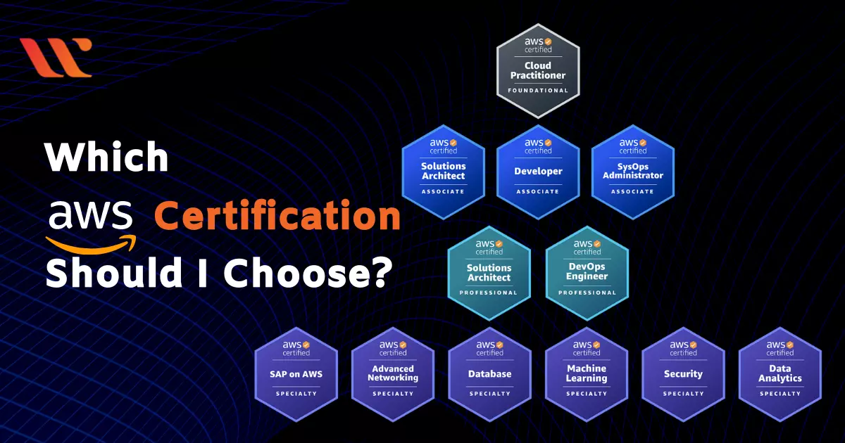
https://www.whizlabs.com/blog/which-aws-certification-should-i-choose/

Slide 13
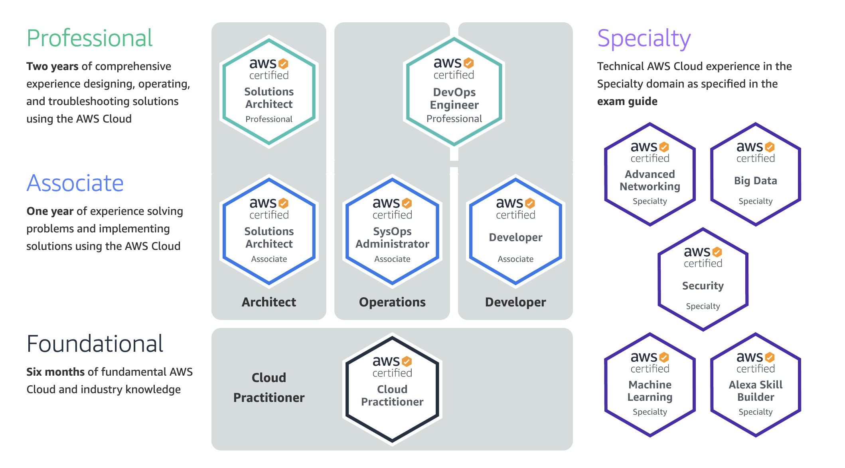
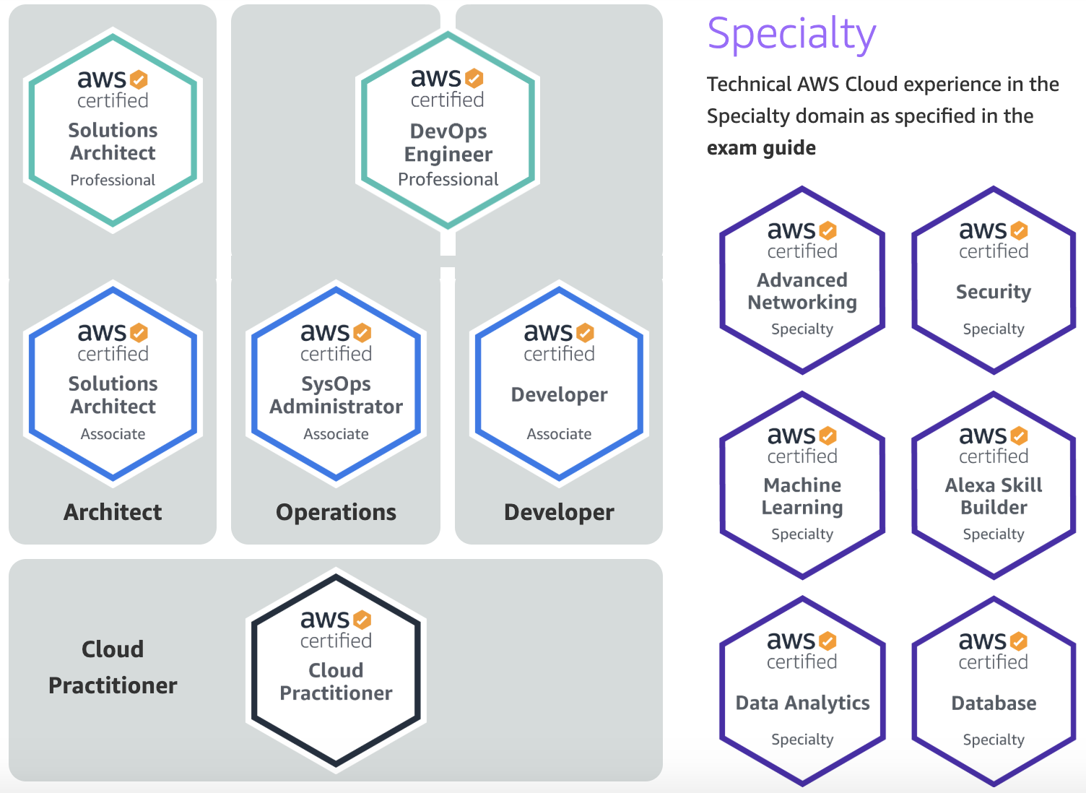

Slide 14
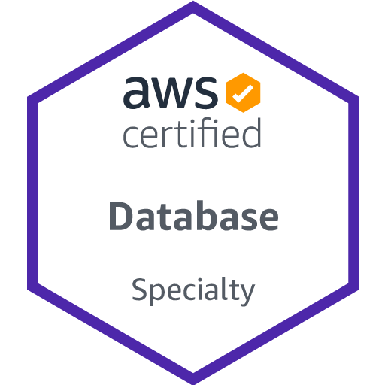
Top AWS Database Certifications
1
This certification enables tenured cloud security professionals to demonstrate their ability to secure the AWS cloud.
Eligible Job roles:
Data Engineer, Data Analyst, Database Architect
Roles:
Understand deploying, migrating, managing, monitoring, and troubleshooting databases; workload-specific database design; and database security
Create CI/CD pipelines, manage infrastructure as code, ensure security and compliance, and collaborate with cross-functional teams to enhance the efficiency and reliability of software delivery.
Knowledge of containerization technologies such as Docker and container orchestration platforms like Amazon ECS, Kubernetes, or Amazon EKS.
Skills & Qualifications
To earn the AWS Certified Speciality, you must possess the following skills and educational qualifications:
5 years of experience with common database technologies,
2 years of hands-on experience with AWS, and expertise working with on-prem and AWS cloud-based relational and No SQL Databases
Salary :
$ 134,793

Slide 15
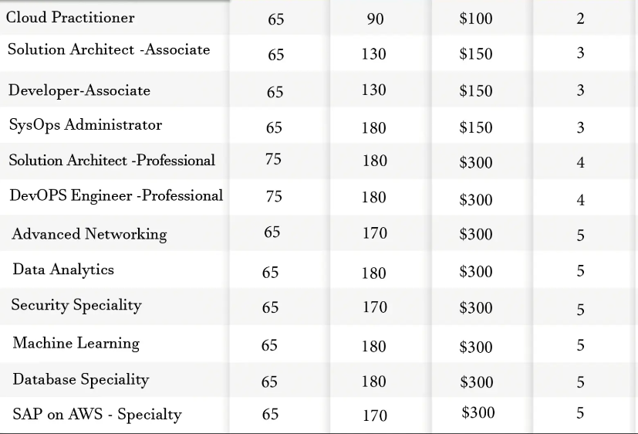
AWS Certifications | No . of Questions | Time Duration | Price | Difficulty Index(0-5)
AWS Certification
Comparisons !!
Certification Validity: 3 years
https://www.whizlabs.com/blog/which-aws-certification-should-i-choose/

Slide 16
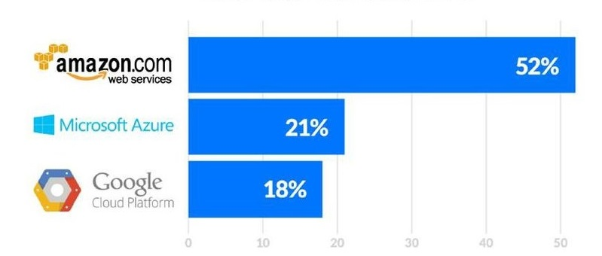
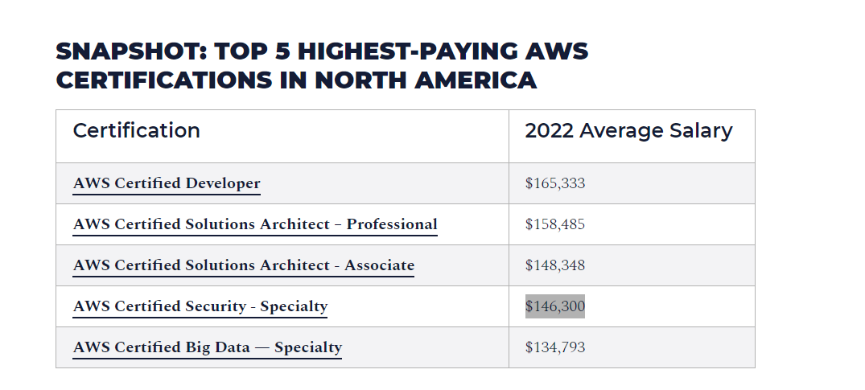
AWS Certification Salaries
https://intellipaat.com/blog/aws-certification-salary/
https://www.skillsoft.com/blog/top-aws-certifications-blog

Slide 17
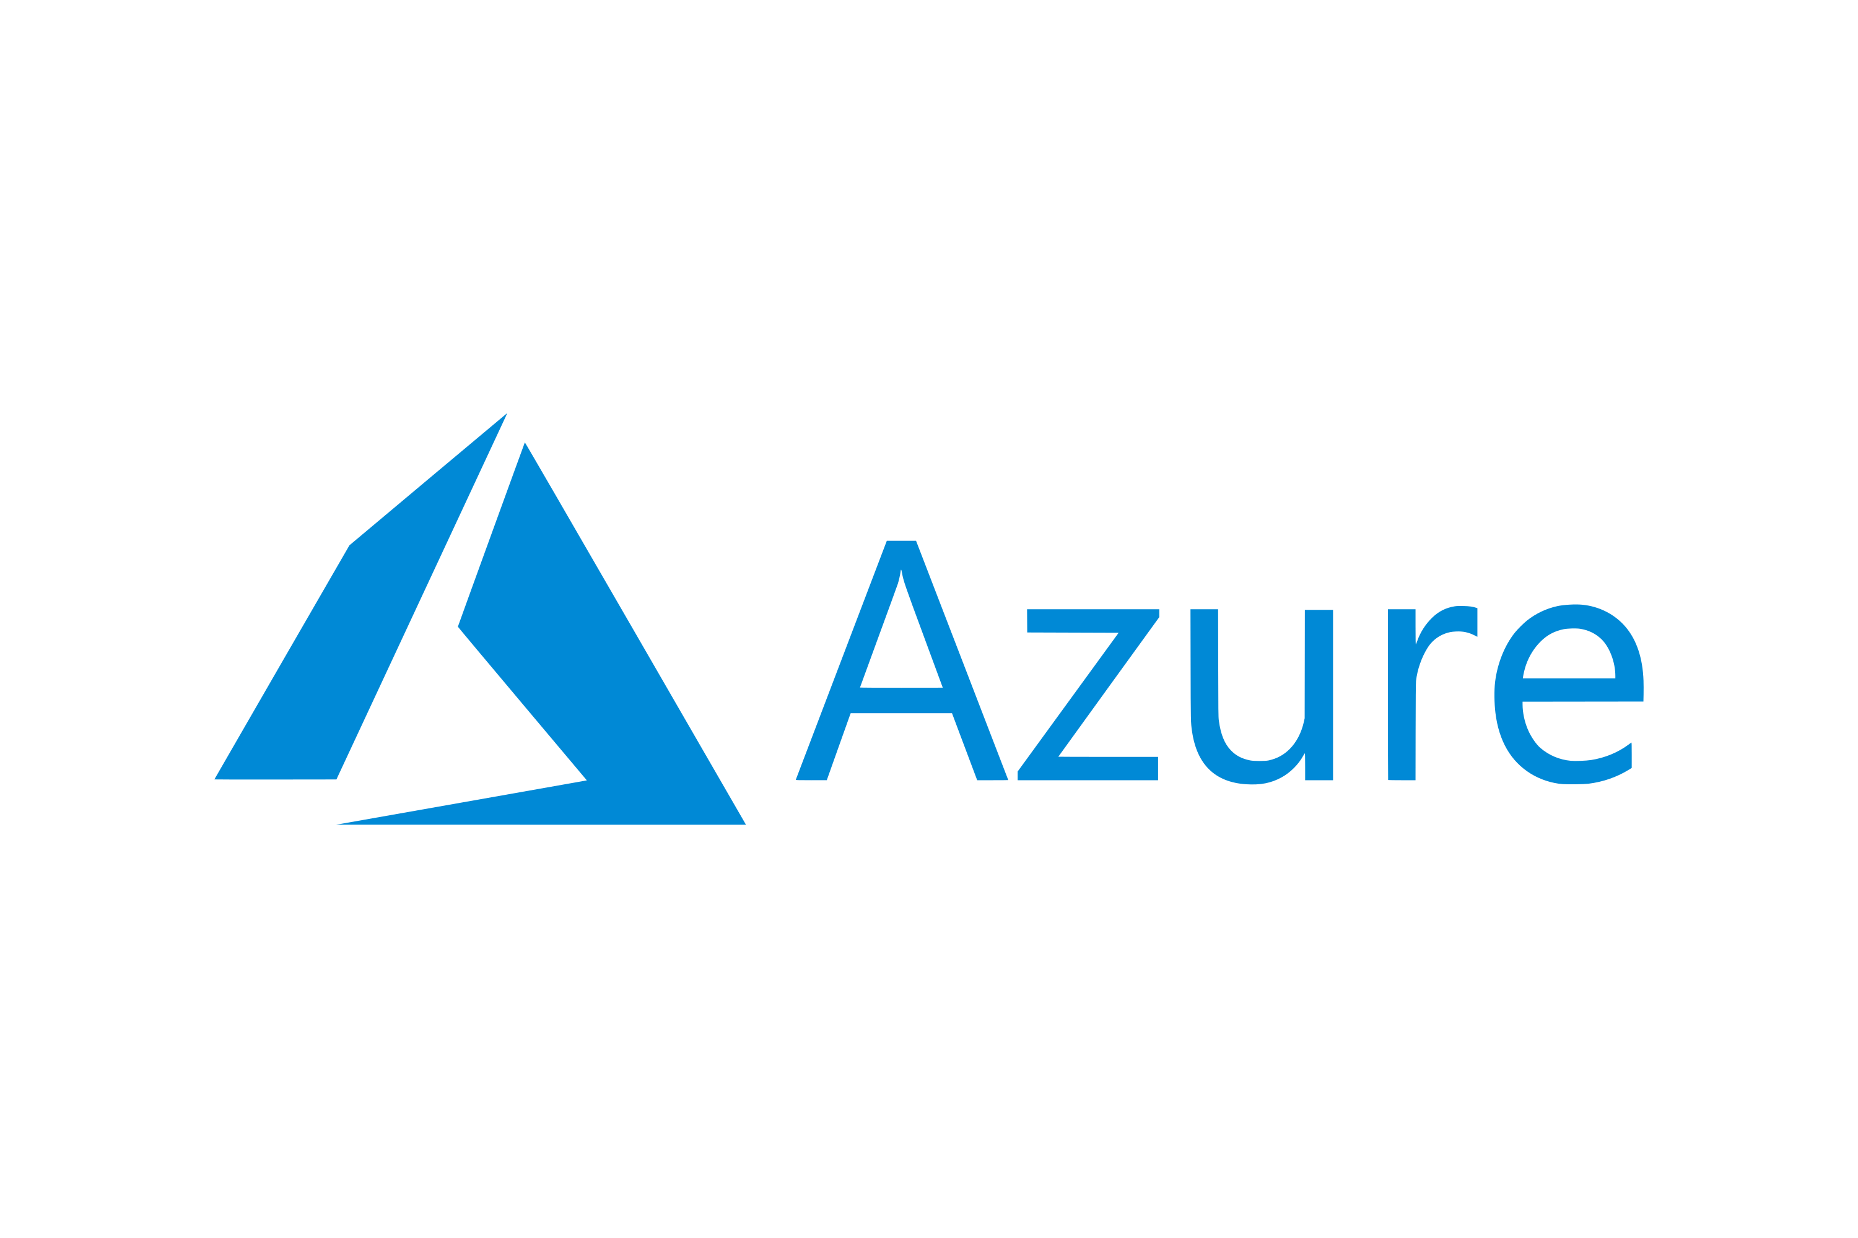
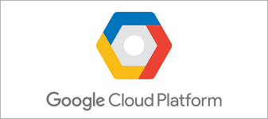






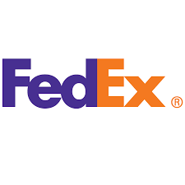










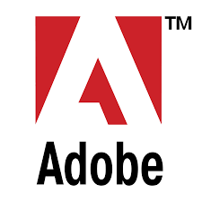



Top Companies that use :
AWS

Slide 18
Study Resources
A Cloud Guru (Paid Resource)
AWS Training and Certification (Free Resource)
Refer to the certification specific - exam guide thoroughly
Pursue AWS Skill Builder Course in AWS Essentials – Skill Builder
Udemy- Ultimate AWS Certified (Paid Resource)
O’REILLY (Paid Resource)

Slide 19

Questionnaire
Question 1:
Which of the following database engines is NOT supported by Amazon RDS?
a) MySQL
b) PostgreSQL
c) Microsoft SQL Server
d) MongoDB
Answer: b) MongoDB

Slide 20
Questionnaire
Question 2:
Scenario: A company is building a new e-commerce platform and needs a database solution. The application requires the flexibility to scale up and down based on demand, and they want to minimize administrative tasks like patching and backups. Which Amazon RDS database engine is the most suitable for their needs?
a) Amazon Aurora
b) Amazon Redshift
c) Amazon DynamoDB
d) Amazon Neptune
Answer: a) Amazon Aurora

Slide 21
Questionnaire
Question 3:
Scenario: Your organization needs to periodically analyze large sets of data using a data warehousing solution. Which AWS service can you integrate with Amazon RDS to efficiently perform such data analysis?
a) Amazon Redshift
b) AWS Lambda
c) Amazon DynamoDB
d) Amazon S3
Answer : a) Amazon Redshift

Slide 22
Questionnaire
Question 4:
Your organization is launching a new online gaming platform that relies on a database. If the primary database goes down, it could result in significant revenue loss. Which Amazon RDS feature should you use to ensure high availability for your database?
a) Amazon RDS Read Replicas
b) Amazon RDS Cross-Region Replication
c) Amazon RDS Multi-AZ deployment
d) Amazon RDS Parameter Groups
Answer : c) Amazon RDS Multi-AZ deployment

Slide 23
Questionnaire
Question 5:
What is the underlying database engine that powers Amazon Aurora?
a) MySQL and PostgreSQL
b) Microsoft SQL Server
c) Oracle Database
d) Amazon DynamoDB
Answer : a) MySQL and PostgreSQL

Slide 24
Questionnaire
Question 6:
Which AWS service is best suited for running data warehousing workloads and complex queries on large datasets?
a) Amazon RDS
b) Amazon DynamoDB
c) Amazon Redshift
d) Amazon Aurora
Answer : c) Amazon Redshift

Slide 25
Questionnaire
Question 7:
What is the primary use case for Amazon Aurora?
a) Data warehousing and analytics
b) High-performance OLTP applications
c) Managing NoSQL databases
d) Real-time stream processing
Answer :b) High-performance OLTP applications

Slide 26
Questionnaire
Question 8:
What is the primary purpose of Amazon RDS Read Replicas?
a) Data warehousing and analytics
b) Load balancing read traffic across multiple database instances
c) Automated daily backups
d) Data transfer between different AWS regions
Answer : b) Load balancing read traffic across multiple database instances

Slide 27


